Slide 1
Today’s lecture
How are “natural” theories of representation challenged by Ferdinand de Saussure?
Why are Saussure’s ideas so radical, even in 2019?
What do we mean when we talk about “the sign” and why is this central to understanding semiotics?

Slide 2

Representation of a cup and saucer

Slide 3
Re-presentation
Representation = literally, to re-present reality in some form
Representation can be language-based (the word “cup” you are reading right now), image-based (a photograph of a cup), sound-based (the sound of the word “cup” in a given language), or even physicalized in some material form (gesture of drinking out of a cup).
We re-present reality so that we may understand it better (e.g. the words we give to things, a work of art) but also so that we can communicate about reality with others through shared systems of representation e.g. language)
Representation involves an act of translation (from this…to this) and some form of mediation using our senses (seeing, hearing, smelling, touching, tasting).

Slide 4

“C – A – T”
Chinese 猫
قط Arabic
French chat
Korean 고양이
Spanish gato

Slide 5
Some theories of representation
One theory of representation is that it is “natural”—it stems from humans trying to capture their experiences or inner states of being in some concrete form
Language has been called “natural” representation because of the presumption that written and spoken language are naturally linked
From language-based representation we derive ideas about the individual in relationship to government (e.g. House of Representatives), law (e.g. an attorney who represents a client), and the public (e.g. positive or negative representations of people in the media or public sphere)

Slide 6

Photographic representation and emoji representation

Slide 7

Conventions of representation

Slide 8
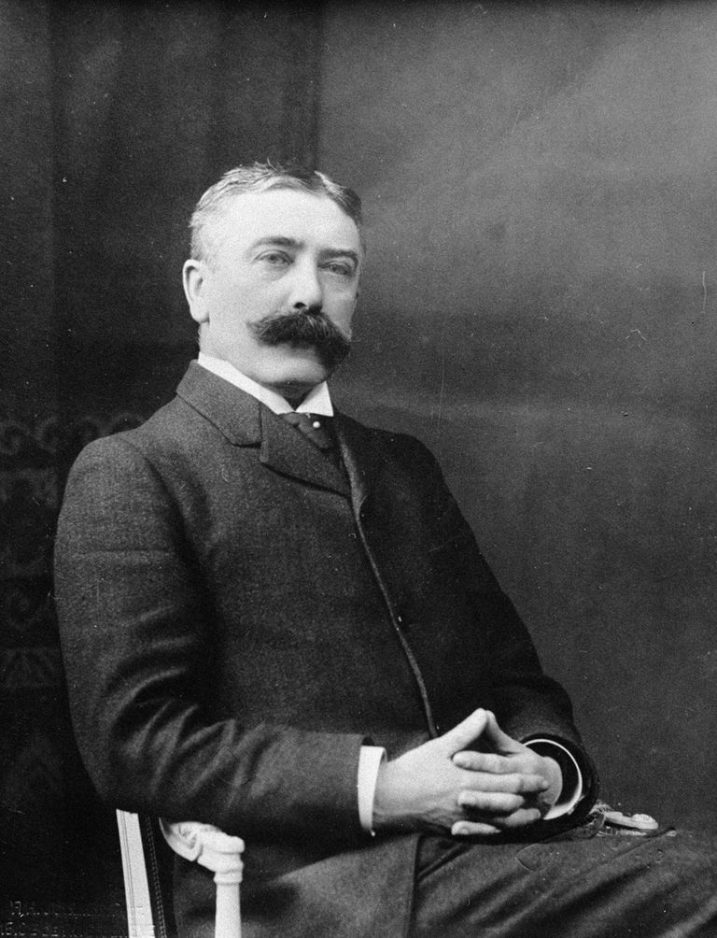
Ferdinand de Saussure (Swiss, 1857-1913)
Developed his ideas about semiotics as a series of lectures in the early 20th century
After his death in 1913, his students put together their notes drawn from his lectures and published Cours linguistique général (Course in General Linguistics) in 1916
Saussure’s ideas are known under the term semiology or semiotics, the “science of signs”
Saussure’s approach to semiotics fundamentally changed how linguists but also scholars across the social sciences and humanities have talked about representation for over 100 years

Slide 9
Saussure’s radical departure
For Saussure, to talk about representation as “natural” is too simplistic; because communication is made by humans, it cannot be “natural” but instead must be an invented system
Saussure describes meaning as made up of two components: the SENSE of a thing and the REFERENCE generated thereby
SENSE and REFERENCE do not refer to external reality, the material world of things; they refer to an internal system of signification
SENSE and REFERENCE give way to Saussure’s concept of THE SIGN

Slide 10
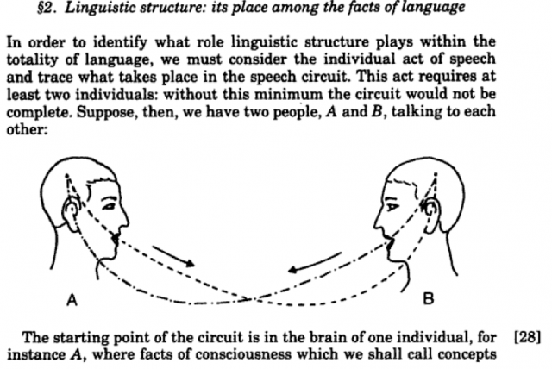
From the Cours linguistique général (1916)

Slide 11
Signs as relational systems
A SIGN is made up of two components that more or less stand in for SENSE and REFERENCE: THE SIGNIFIER and THE SIGNIFIED
A SIGN holds both of these two things together simultaneously, the union of SIGNIFIER and SIGNIFIED
According to Saussure, a SIGN is only meaningful within the system of signs to which it belongs; it does not have a meaning independent of that system
In addition, according to Saussure, a SIGN is meaningful because it is NOT another SIGN; it’s meaning is therefore RELATIONAL and INTERDEPENDENT

Slide 12
Sign = signifier + signified

Slide 13
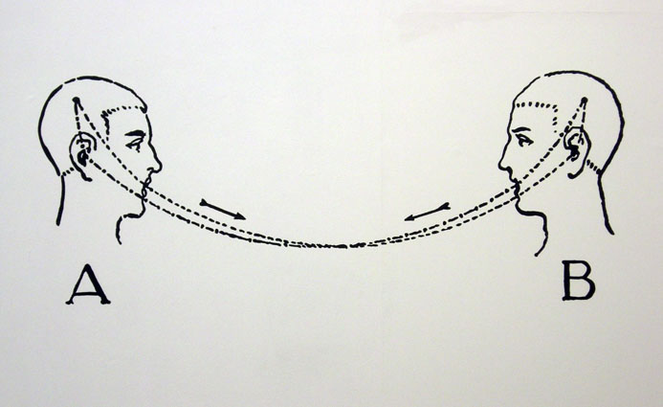
How “signifier” and “signified” are unified in “the sign”

Slide 14
Chandler on Saussure
For Saussure, “meaning is derived from the way each language imposes its relational system on the continuum of thought and not directly from things in the world. This is radically different from traditional models of the sign—in which meaning is tied to representation. Saussure’s signified is a concept in the mind—not a thing but the notion of a thing” (15, italics in original).

Slide 15
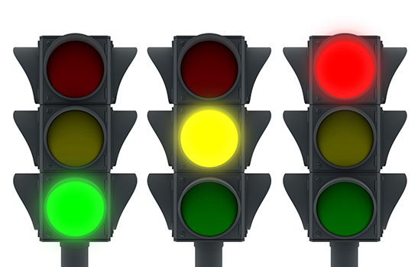
System of Signification #1: Traffic Light

Slide 16
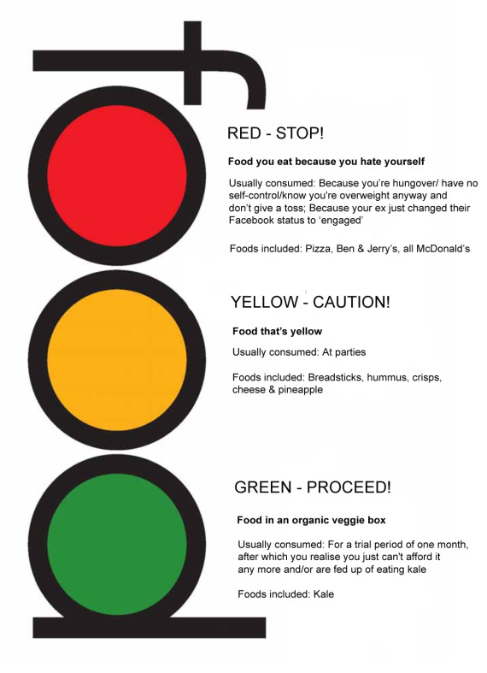
System of Signification #1: Traffic Light

Slide 17
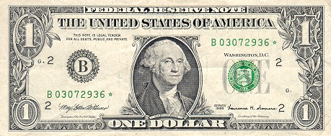
System of Signification #2: Money

Slide 18
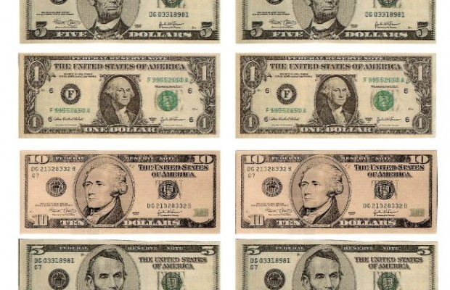
System of Signification #2: Money

Slide 19


System of Signification #3: Smell

Slide 20
Signs only work within systems of signification that are relational and interdependent

Slide 21
Frederic Jameson on systems of signification
“It is not so much the individual word or sentence that ‘stands for’ or ‘reflects’ the individual object or event in the real world, but rather that the entire system of signs…lies parallel to reality itself; that it is the totality of systematic language, in other words, which is analogous to whatever organized structures exist in the world of reality”
(Jameson, 1972; quoted in Chandler, 19)

